Slide 1
Term Project Recognition of Handwriting
CSSE 463-01
Patrick Rippl, Brandon Rudolph, Yuankai Wang, Chelsey Yin

Slide 2
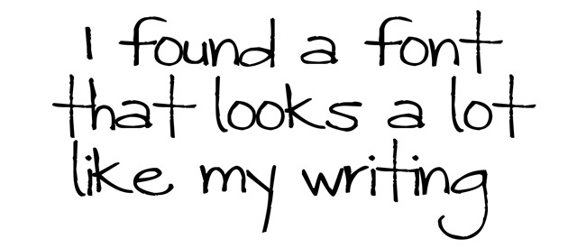
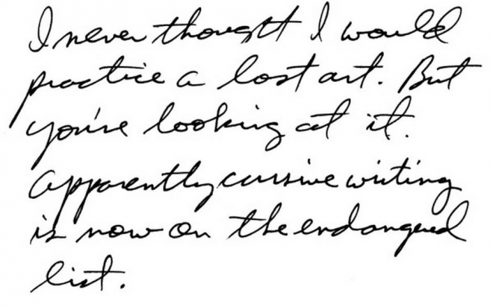
Motivation
Why do we need handwritten character recognition?
Optical Character Recognition (OCR) already exists for typeset characters
OCR for handwritten characters is much more limited
Possible applications
Difficult to classify because of their irregularities and tendency to flow together
Notes:
Difficulties:
Writing style narrow or connect each letter. Even use morphological function cannot separate them.
Application:Identification of person’s handwriting, data entry, search/find in handwritten documents
Convert handwritten to computer file such as txt file

Slide 3
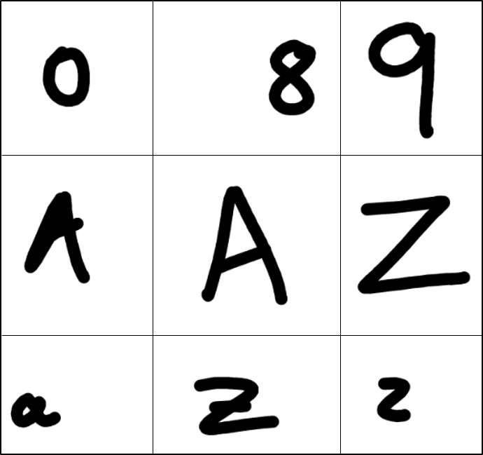

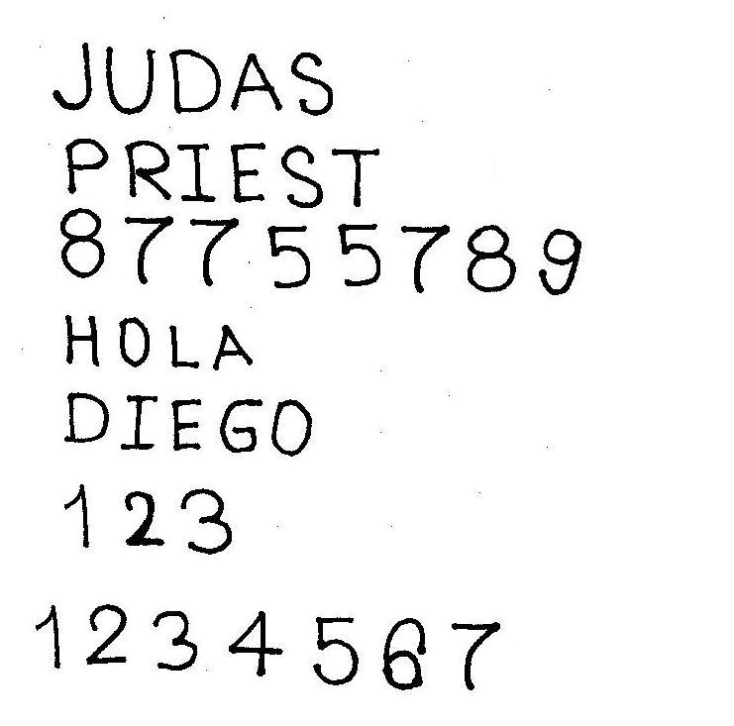
Approach
Train Data
AlexNet
Test Data
Pre processing
Train
Classify
62 Characters
Resolution
Notes:
Train Data and Test Data (noisy or clear, more lines, etc -> results)
Train Data (62 characters, high resolution)
Issues: Dots on i’s, resolutions, ‘large’ white area.
Pre processing: Padding, Segmentation, resizing

Slide 4
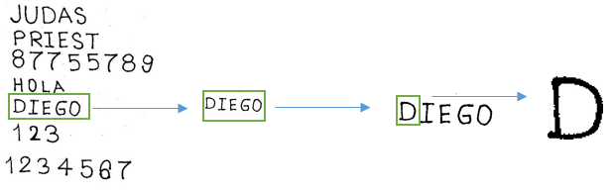
Segmentation
Average position
Setting threshold
Need every character to be clearly separated
Notes:
Difficulties:
Writing style narrow or connect each letter. Even use morphological function cannot separate them.
Application:Identification of person’s handwriting, data entry, search/find in handwritten documents
Convert handwritten to computer file such as txt file

Slide 5
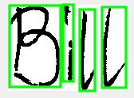

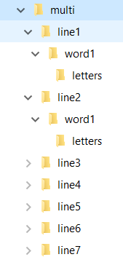
Image storage and examples
Notes:
Difficulties:
Writing style narrow or connect each letter. Even use morphological function cannot separate them.
Application:Identification of person’s handwriting, data entry, search/find in handwritten documents
Convert handwritten to computer file such as txt file

Slide 6
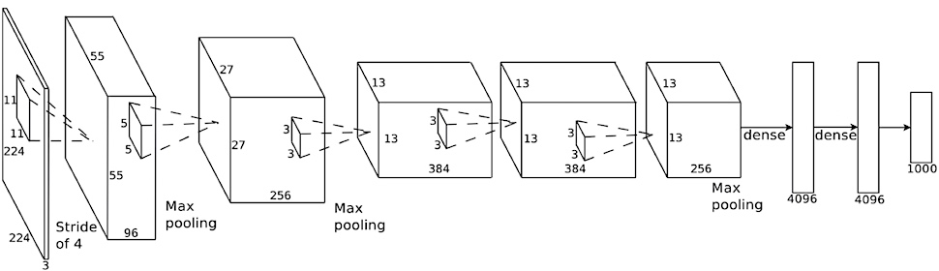
Network Training
AlexNet was the CNN used for classification
The architecture was modified to identify 62 classes, with 55 images of each character for training.
Notes:
15 Epochs, Minibatch size of 128
Best accuracy with the above settings was 95.31%
55 images of each character

Slide 7

Data Processing
AlexNet uses 227x227 images
Simple resizing distorts the shape of the character
An alternate approach is needed

Slide 8



Data Processing
Find
bounding box
227
VS
900 x 1200
n
Capital O
Lowercase O
Finding bounding boxes before resizing preserves the character shape.
In some cases, this resizing process causes similar characters to be confused.
Notes:
Mention data augmentation images

Slide 9

Data Processing
Amount of training data was increased with data augmentation
Data augmentation allowed for the reuse of training images by shifting the character within the given whitespace.

Slide 10

Notes:
Example image. Already segmented in the folder structure.
Classify using pretrained net, to show the current results.

Slide 11
Demo Time

Slide 12

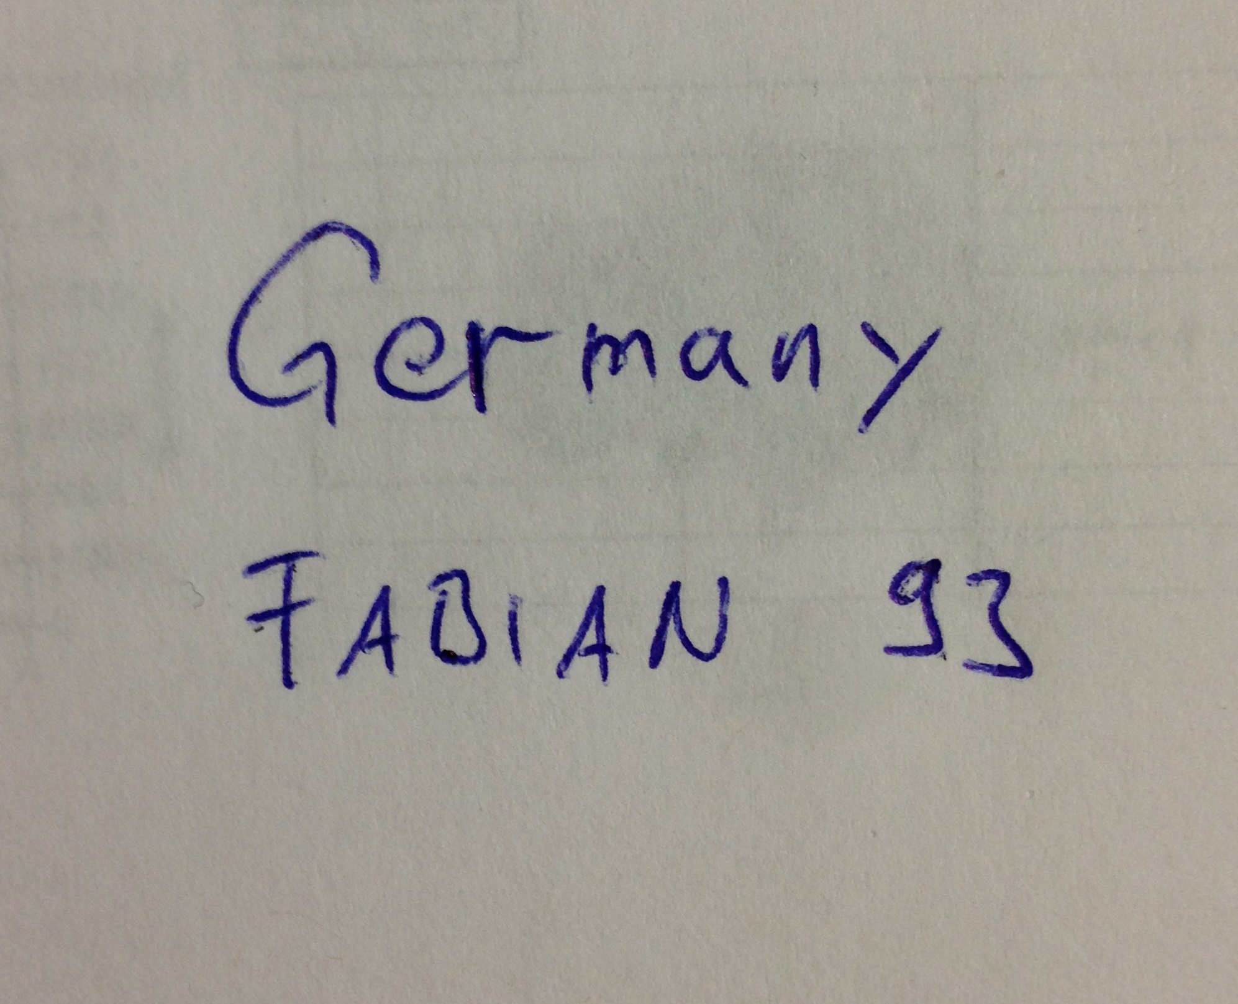
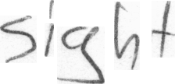
Results
Words
Sentences
Need more time to work on paragraphs (actually implementation of flexible threshold would be enough)
“4” “T” “7” “B” “8”

Slide 13

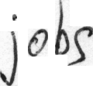

Problems and lessons learned
Padding
Unify the size of train set and test set
Bigger problem: Segment connected letters
Bigger problem: Training of net with more data

Slide 14
Thank you for your attention
Questions?

